Slide 1
PATCH VALIDATION TOOL

Slide 2
Agenda
Why do we need this tool
What Does this tool Do ?
How does this tool Work ?
Q&A

Slide 3
Why do we need this tool ?
To Avoid Direct rejections.
With less user intervention ,this patch can be validated.
Verify the patch with the configuration GM+Preq+Patch.
Build confidence while releasing the patch.

Slide 4
What Does this tool Do ?
This tool will install the GM Setup.exe on the server or VM based on the user selection.
Installs all the pre-requisites mentioned .
Installs the patch to be verified.

Slide 5
How does this tool Work ?
Before using this tool, we need to Copy all the pre-requiste patches in the below location :-
\\pdlfiles-ba\pdlfiles\eng\Sustaining_Patches and
\\pdlfiles\pdlfiles\eng\Sustaining_Patches
This tool installs the setup.exe present in the Ex:-
\\bauser\Fiery-products\Sustaining_builds\EFI_Bernstein1.0J\GM
This tool installs all the pre-requisites mentioned and the patch to be validated.
Finally it triggers a calculus request based on the above inputs.
Ex:- https://calculus.efi.com/requests/1207154

Slide 6
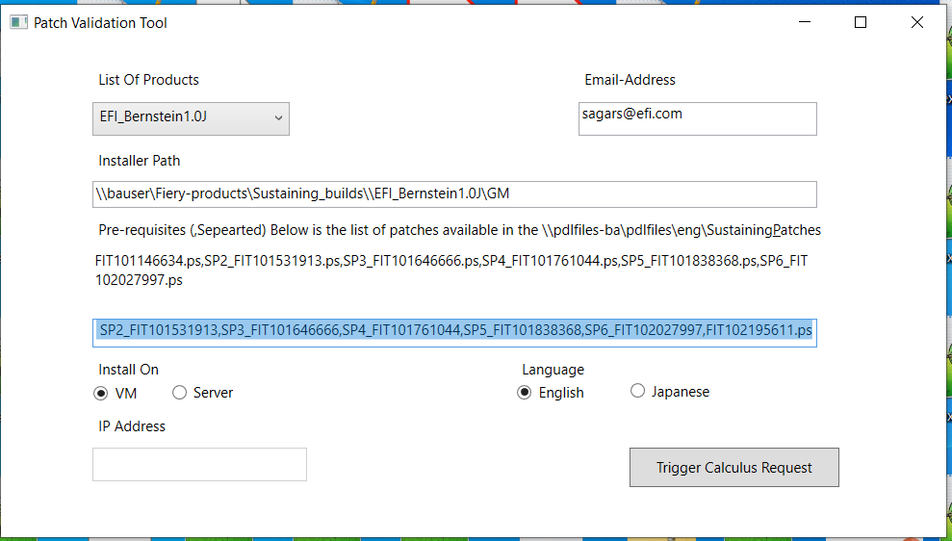
Tool Screenshot

Slide 7
Q&A

